Slide 1




Daman-Hayat AI
Transforming Prevention into Profit
Investment Opportunity
AED 55M ($15M)
1,893% ROI • 15,000 Lives Saved

Slide 2



UAE Nationals Live 16 Years in Poor Health
Lifespan
Healthspan
83.3
67.3
16
YEARS
YEARS
Worldometers 2025
Years of Suffering
WHO 2025
1M+
AED 19B
80%
Thiqa Members at Risk
Annual Healthcare Costs
Chronic Disease is Preventable
The healthspan gap has
widened 45% since 2000
and continues to grow every year

Slide 3

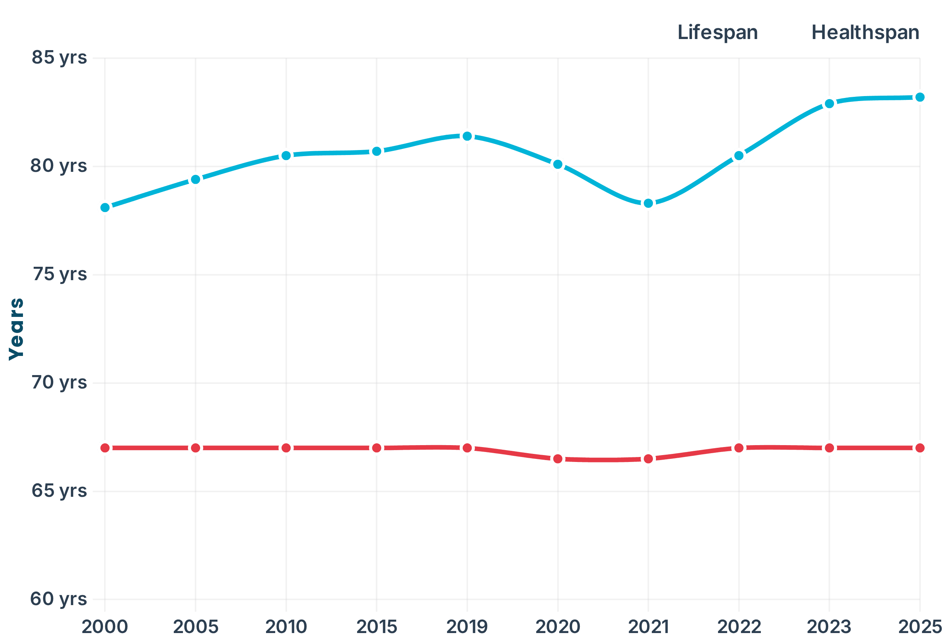
The Healthspan Crisis: Living Longer, But Sicker
UAE Healthspan vs Lifespan Trend (2000-2025)
The Crisis
Medical advances keep us alive longer, but don't keep us healthy longer. The gap has widened from 11 to 16 years—that's 16 years lived with chronic disease, disability, and diminished quality of life.
The Economic Opportunity
Adding 1 year of healthspan = 4-5% of GDP annually
Total UAE
AED 60-75B/year
Thiqa (1M members)
AED 5-8B/year
Hayat AI (15K members)
AED 750M-1.2B
Source: Nature Aging (2021), NFX (2025)
Source: WHO Global Health Observatory, Worldometers (2025), PMC (2023)

Slide 4

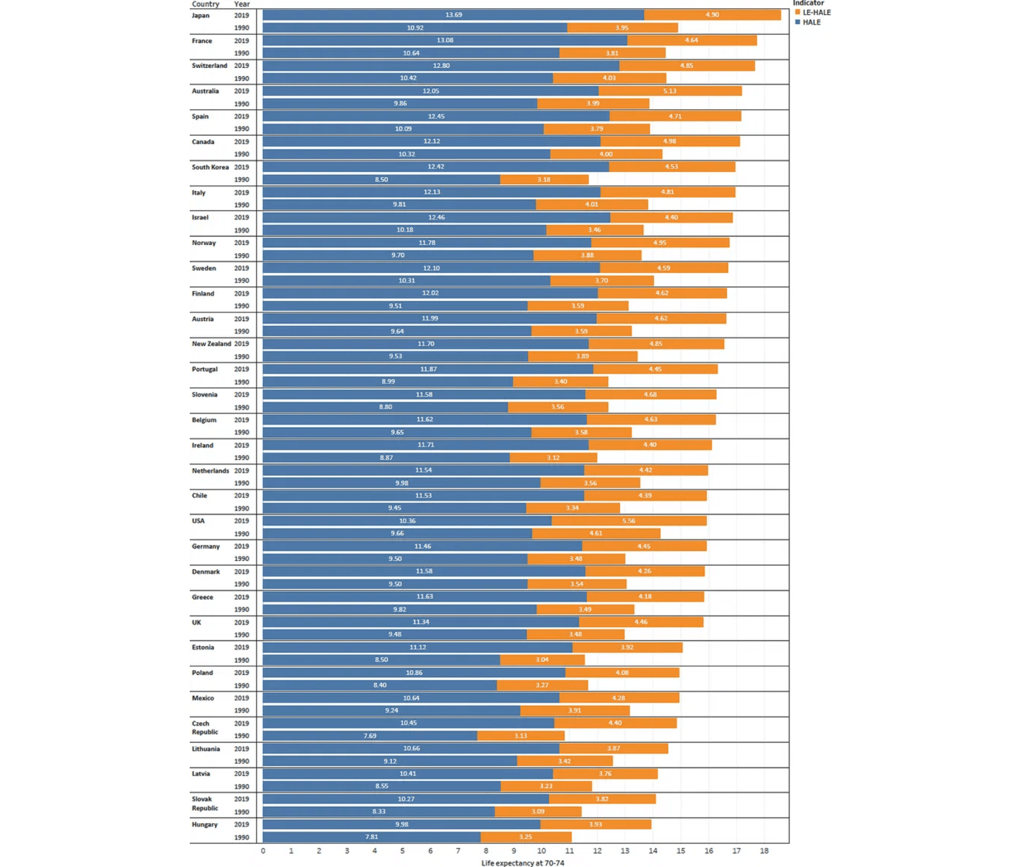
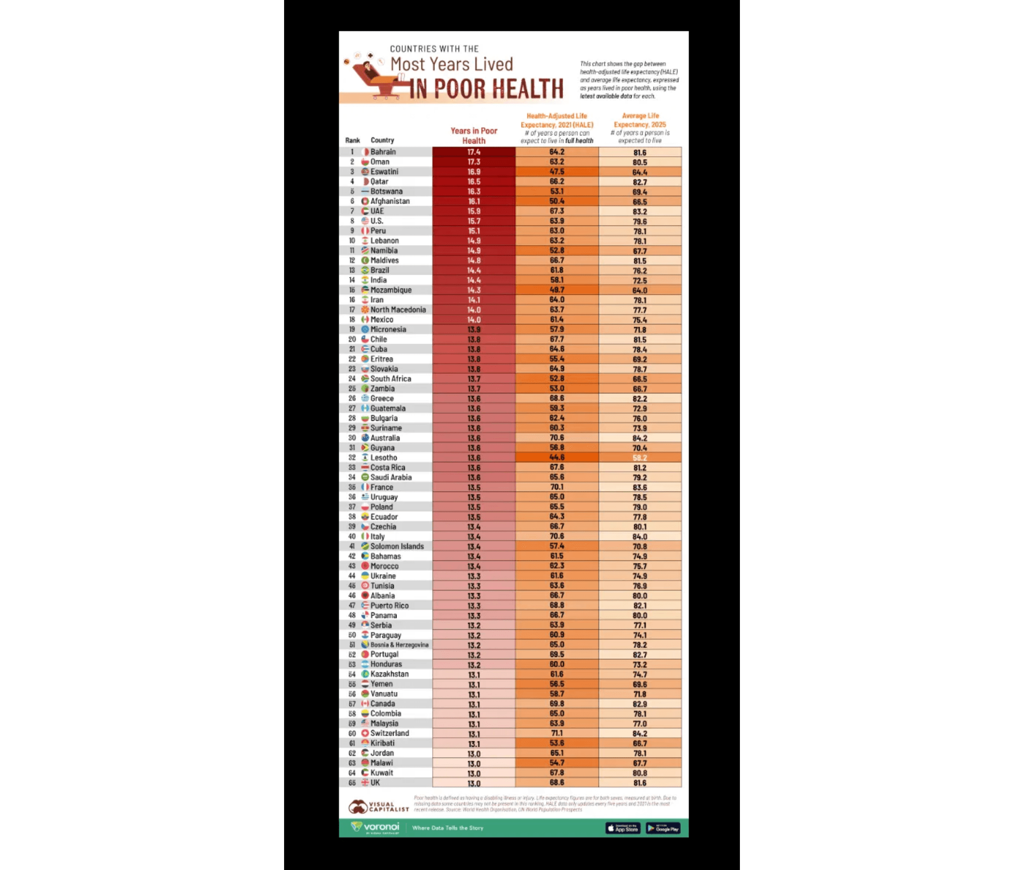
A Global Crisis: UAE Ranks #7 Worst
Years Lived in Poor Health - International Comparison
UAE ranks #7 globally with 15.9 years lived in poor health (Health-Adjusted Life Expectancy 67.3 years, Life Expectancy 83.2 years). This isn't just a local challenge—it's a global crisis where UAE is among the worst performers. The opportunity to improve healthspan is massive, and the urgency is clear.

Slide 5

The Financial Impact: Year-by-Year
+1 Year Lifespan (Without Healthspan)
+1 Year Healthspan (Closing the Gap)
The Cost of Living Longer, But Sicker
The Value of Living Longer AND Healthier
Thiqa Insurance (Gov Funded)
-AED 7,000
Healthcare Savings
+AED 184,000
Direct Healthcare Costs
-AED 30,000
Productivity Restored
+AED 60,000
Government Subsidies
-AED 25,000
Family Burden Removed
+AED 40,000
Lost Productivity (Patient)
-AED 60,000
Economic Value Created
+AED 30,000
Family Caregiver Burden
-AED 40,000
Minus Healthy Year Cost
-AED 8,250
Indirect Economic Costs
-AED 30,000
GDP Multiplier (4.5%)
+AED 68B
Total Cost Per Person
-AED 192,000
Net Value Per Person
+AED 184,000
Annual Impact on Thiqa Cohort in Gap (35,556 people aged 67-83)
Current Burden: AED 6.83B/year | Hayat AI Savings Potential: AED 2.07B over 5 years
*Based on cohort analysis: 35,556 Thiqa members currently in healthspan-lifespan gap (ages 67-83), with 2,222 new entrants annually. Hayat AI targets 15,000 members, of which ~4,500-6,000 are in relevant age group. Sources: World Bank, WHO, SCAD, PMC research.

Slide 6

The Solution: Detection + Monitoring + Prevention
1
Early Detection
2
Behavior Change
Secondary Prevention • Proactive
Primary Prevention • Proactive
AI-powered screening using five data sources detects disease 5-10 years before symptoms.
Mobile app with AI coaching and wearable integration drives sustained lifestyle change.
🩸
Blood Biomarkers
📱
Mobile App
Traditional lab tests for metabolic markers
Food tracking, health scores, progress dashboard
🧬
Genome Analysis
🤖
AI Nutritionist
Accelerated access via Thiqa partnership
Personalized meal plans, Emirati cuisine, Ramadan-aware
🏥
Medical Imaging
🎮
Gamification ENHANCED
CT, MRI, ultrasound for structural issues
Real-time wearable feedback • Challenges • Leaderboards
👁️
AI Retinal Screening NEW
Streak tracking • Social competition • Rewards
Google Health AI • Detects diabetes, CVD, stroke risk
👥
Social Engagement
90% cheaper than CT/MRI • Smartphone-based
Community support, family challenges, peer motivation
⌚
Wearable Devices NEW
⚠️
Early Warnings NEW
Continuous heart rate, SpO2, sleep, activity
Wearable alerts for abnormal vitals • Sleep issues • Inactivity
24/7 monitoring • Early warning alerts
Continuous monitoring • Predictive analytics
Impact:
Impact:
75-95% reduction in late-stage treatment costs
Prevent disease from developing in the first place
The Only Integrated Platform
Combining multi-modal early detection (5 data sources) + continuous wearable monitoring + sustained behavior change
Google Health Partnership
24/7 Continuous Monitoring
Culturally Adapted

Slide 7



AED 40 Billion Lost Every Year
While preventable diseases steal health, wealth, and happiness from 1M+ UAE nationals
AED 40B
Total Annual Cost
AED 19B
AED 21B
Healthcare Expenditures
Lost Productivity
UNDP 2024
UNDP 2024
1M+
AED 11B
80%
Thiqa Members Affected
Thiqa Market Size (Est.)
Preventable Through Lifestyle

Slide 8

Multi-Modal Early Detection: Six Data Sources
NEW
NEW
NEW
🩸
🧬
🏥
👁️
⌚
🦴
Blood Biomarkers
Genome Analysis
Medical Imaging
AI Retinal Screening
Wearable Devices
DEXA Scan
Traditional lab tests for metabolic markers
UAE Genome Database access via Thiqa
CT, MRI, ultrasound for structural issues
Continuous 24/7 monitoring
Visceral fat + bone density
Powered by Google Health AI
AED 200-500
Accelerated Access
AED 1,000-5,000
Optional
AED 367-734
AED 100
AI Retinal Screening
⌚
Wearable Devices
🦴
DEXA Scan
👁️
Powered by Google Health AI • 600K+ screenings globally
Optional • Continuous 24/7 Health Monitoring
Annual Body Composition Screening
Currently Available Sensors:
What It Detects:
What It Detects:
✓ Heart rate (continuous PPG)
✓
Visceral fat
(fat around organs & heart)
✓ Diabetic retinopathy (5-10 years early)
✓ Blood oxygen (SpO2)
✓ Bone mineral density (osteoporosis risk)
✓ Cardiovascular disease risk (heart attack/stroke)
✓ ECG/EKG (single-lead)
✓ Muscle mass distribution
✓ Pre-diabetes (years before diagnosis)
✓ Sleep tracking (stages, quality)
✓ Aortic calcification (CVD risk)
✓ Blood pressure abnormalities
✓ Activity (steps, calories, exercise)
✓ Body composition trends
✓ Stroke risk via vessel patterns
✓ Skin temperature
Why It Matters:
How It Works:
Coming Soon (2025-2027):
•
Most people don't know they have visceral fat
Hidden danger:
• Smartphone-based retinal camera (~AED 100-367)
⏳ Blood pressure (cuffless, FDA pending)
• AI analysis in real-time
•
Visceral fat linked to heart disease, stroke, diabetes
⏳ Sweat biomarkers (cortisol, lactate)
Silent killer:
• Quarterly or bi-annual scans
⏳ Hydration status
•
Measure if fat is decreasing, muscle increasing
• More accurate than CT/MRI for some conditions
Progress tracking:
Gamification Benefits:
Cost Advantage:
• Real-time feedback & rewards
AED 100 vs. AED 1,000-5,000 (CT/MRI)
• Social challenges & leaderboards
Clinical Significance:
90-95% cost reduction for comparable insights
• Early warning alerts
Gold standard for visceral fat measurement
• Personalized AI goal adjustment
10-20 min scan • Annual screening • Minimal radiation
Only Platform with 6 Data Sources
Competitors use 1-2 data sources. We combine blood + genome + imaging + retinal + wearables + DEXA for the most comprehensive health picture available.
Google Health Partnership • Multi-Modal AI • Continuous Monitoring

Slide 9



We Don't Just Predict Disease—We Prevent It
Early Detection
Behavior Change
PROACTIVE
PROACTIVE
•
AI-powered screening using blood biomarkers
•
Personalized nutrition (Emirati cuisine)
•
Genome analysis with UAE-specific data
•
Gamification and community engagement
•
Advanced medical imaging integration
•
AI health coach with real-time feedback
•
Detects disease 5-10 years before symptoms
•
Cultural adaptation (Ramadan-aware)
•
Accelerated access to 800K+ genome database
•
Prevents disease from developing
Investment
5-Year Return
ROI
Lives Saved
AED 55M
AED 284M
1,893%
15,000

Slide 10






















The Only Integrated Solution in the Market
Capability
Daman-Hayat AI
Govt AI Platform
Wellness Apps
Precision Med
Early Detection (5-10 years)
Behavior Change & Prevention
Genome Integration
Thiqa Integration
Cultural Adaptation
Gamification & Engagement
Strong Capability
Limited Capability
Not Offered
We are the only platform combining AI early detection with sustained behavior change—purpose-built for the Thiqa population

Slide 11



1 Million+ Thiqa Members, AED 11B Market
1M+
AED 11B
Thiqa Members
Market Value (Est.)
100%
2,000+
UAE Nationals Coverage
Hospital Network
Strategic Advantages
Thiqa-Native Platform: Built specifically for 1M+ members with pre-integrated network
Accelerated Data Access: Streamlined access to UAE Genome Database (800K+ genomes)
Government Partnership: Daman backing provides credibility and regulatory pathway
Lower CAC: Thiqa endorsement reduces customer acquisition costs significantly
Market Penetration Strategy
YEAR 1
YEAR 3
YEAR 5
1,000
5,000
15,000
0.1% penetration
0.5% penetration
1.5% penetration

Slide 12





Precision Medicine Trained on Emirati Population
Why UAE-Specific AI Matters
Western Models
Our Emirati-Specific Model
Generic algorithms trained on European and American populations. Completely misses Middle Eastern genetic variations and metabolic patterns.
AI trained on Emirati-specific data. Accounts for regional genetic markers in diabetes, cardiovascular disease, and metabolic disorders unique to the population.
Cultural Adaptation
Population Scale Precision
Emirati cuisine-based nutrition plans, Ramadan-aware health protocols, and family-centered wellness programs that respect local traditions.
Delivering precision medicine for 1 million+ Thiqa members simultaneously, not just individual patients in clinical trials.
Competitors use generic Western models that don't account for Emirati genetics or culture. We deliver precision medicine at population scale powered by UAE-specific data.

Slide 13








UAE Genome Database Integration
800K+
Accelerated
Genomes Sequenced
Data Access via Thiqa Partnership
Specific Applications
Population-specific genetic risk profiling
Emirati metabolic syndrome patterns
Regional diabetes Type 2 markers
Cardiovascular disease variations
Three-Part Precision Medicine Integration
Genetic Predisposition
Current Biomarkers
Lifestyle Integration
Identify inherited disease risks specific to Emirati genetics
Real-time blood analysis and metabolic tracking
Personalized interventions based on combined data

Slide 14





Gamification Drives 3-5x Higher Engagement
80% of chronic disease is preventable through lifestyle changes, but detection without behavior change leads to anxiety without action
AI Nutritionist
Gamification Engine
•
Personalized meal plans based on Emirati cuisine
•
Daily health scores responding to user actions
•
Real-time food tracking with cultural food database
•
Social challenges and community support
•
Ramadan-specific nutrition guidance
•
Rewards and achievement system
•
Genetic + biomarker-based recommendations
•
Leaderboards and friendly competition
Real-Time Feedback
Cultural Integration
•
Biomarker tracking and trend analysis
•
Prayer time-aware activity scheduling
•
Predictive health scores
•
Family-centered wellness programs
•
Personalized intervention recommendations
•
Arabic language with cultural nuances
•
AI coach providing immediate guidance
•
Emirati social norms and traditions
Why This Works
3-5x
40%+
Sustained
Higher Engagement vs Standard Apps
Increased Adherence with Cultural Relevance
Long-Term Motivation Through Community

Slide 15



Proven Public-Private Partnership Model
🇸🇬
Singapore
🇰🇷
South Korea
🇺🇸
US Medicare
2000-2020
2012-Present
2010-Present
National health screening program combining government funding with private sector innovation and delivery.
Population-wide genome project integrated with preventive care delivery through public-private collaboration.
Preventive care coverage expansion through public insurance with private provider network delivery.
Result
Result
Result
15% Reduction in Diabetes
20% Reduction Late-Stage Cancer
$7 Saved per $1 Invested
Our Partnership
UAE Vision 2030 Alignment
Daman
- National Health Insurance
Longevity & Healthy Aging Initiatives
Abu Dhabi DoH
- Regulatory Support
Precision Medicine & Genomics Strategy
Thiqa Network
- 2,000+ Hospitals
Economic Diversification Beyond Oil

Slide 16

1,893% ROI in Optimal Scenario
Investment Required: AED 55M ($15M)
Optimal Scenario
Realistic Scenario
Worst Case
1,893%
927%
360%
Return on Investment
Return on Investment
Return on Investment
5-Year Return
5-Year Return
5-Year Return
AED 284M
AED 180M
AED 90M
Net Profit
Net Profit
Net Profit
AED 229M
AED 125M
AED 35M
Members Served
Members Served
Members Served
15,000
10,000
5,000
Market Penetration
Market Penetration
Market Penetration
1.5%
1.0%
0.5%
Even in the worst case scenario, investors more than triple their investment while transforming preventive health for thousands of UAE nationals

Slide 17

Strong Unit Economics: 37.8x LTV/CAC
Lifetime Value
÷
Acquisition Cost
=
LTV/CAC Ratio
AED 18,900
AED 500
37.8x
Payback Period: 3.3 months | Break-even: Month 18
70%
20%
10%
Thiqa Partnership
Direct-to-Consumer
Data Licensing
Primary Revenue
Secondary Revenue
Future Revenue
•
Per-member-per-month (PMPM): AED 150
•
Premium features: AED 99/month
•
Anonymized health insights to researchers
•
Outcome-based bonuses for health improvements
•
Advanced genetic insights
•
Pharma partnerships for clinical trials
•
Personalized coaching
•
Population health analytics
•
Cost savings sharing with Thiqa
AED 150
5 Years
2.1x
80%+
Monthly Revenue per Member
Average Member Lifetime
Revenue Multiplier
Annual Retention Rate

Slide 18

5-Year Path to 15,000 Members
Year 1
Year 2
Year 3
Year 4
Year 5
Foundation
Validation
Growth
Expansion
Scale
1,000
3,000
5,000
10,000
15,000
Members
Members
Members
Members
Members
Key Milestones
Key Milestones
Key Milestones
Key Milestones
Key Milestones
•
Platform development
•
Expand to 2,000 members
•
Scale to 5,000 members
•
Double to 10,000 members
•
Reach 15,000 Thiqa members
•
Thiqa integration
•
Reach 3,000 by year-end
•
Launch D2C tier
•
Expand to Dubai, Sharjah
•
Presence in 3 GCC countries
•
Pilot launch 500 beta users
•
Refine AI models
•
Begin data licensing
•
International pilot (KSA, Qatar)
•
AED 284M revenue (optimal)
•
Scale to 1,000 members
•
Demonstrate biomarker improvements
•
Achieve profitability
•
Regional market leader
•
Prepare Series B funding
•
Validate unit economics
•
15%+ health outcomes
•
80%+ retention rate
•
Regional health leader
•
Prove 30%+ engagement
Building
Validating
Profitable
Expanding
Market Leader
Key Success Metrics
30%+
15%+
80%+
50+
Engagement Rate
Biomarker Improvement
Annual Retention
NPS Score

Slide 19

AED 55M Investment Allocation
Total Investment: AED 55M ($15M)
Technology & AI Development
30%
AED 16.5M
AI model development and training • Platform engineering and infrastructure • Genome database integration • Mobile app development (iOS/Android) • Cloud infrastructure and security
Clinical Operations & Partnerships
25%
AED 13.75M
Thiqa integration and partnership management • Clinical validation studies • Hospital network integration • Medical advisory board • Regulatory compliance
Marketing & Customer Acquisition
20%
AED 11M
Brand development and positioning • Digital marketing campaigns • Community engagement programs • Sales team and partnerships • Customer success operations
Operations & Overhead
15%
AED 8.25M
Team salaries and benefits • Office space and facilities • Legal and professional services • Insurance and risk management • Administrative costs
Contingency & Reserve
10%
AED 5.5M
Unexpected regulatory requirements • Market condition changes • Technology pivots • Extended runway if needed
Burn Rate Timeline
Year 1
Year 2
Year 3
Year 4-5
Profitability
AED 20M
AED 18M
AED 12M
Self-Sustaining
Year 3

Slide 20






The Investment Decision
Massive Market Opportunity
Proven Business Model
Unique Competitive Position
Exceptional Returns
Impact Beyond Returns
The Investment Opportunity
Investment
5-Year Return
ROI
Lives Saved
AED 55M
AED 284M
1,893%
15,000
This is not just an investment—it's a chance to reshape the future of health for an entire nation while achieving exceptional financial returns
Next Steps
1
Due Diligence & Financial Review
2
Meet Daman/Thiqa Partnership Team
3
Review Technology & AI Capabilities
4
Finalize Investment Terms
5
Launch Q1 2026

